Slide 1
Propositional and First-Order Logic

Slide 2
Propositional Logic: Review

Slide 3
Big Ideas
Logic is a great knowledge representation language for many AI problems
Propositional logic is the simple foundation and fine for some AI problems
First order logic (FOL) is much more expressive as a KR language and more commonly used in AI
There are many variations: horn logic, higher order logic, three-valued logic, probabilistic logics, etc.

Slide 4
Propositional logic
Logical constants: true, false
Propositional symbols: P, Q,... (atomic sentences)
Wrapping parentheses: ( … )
Sentences are combined by connectives:
  ∧and [conjunction]
  ∨ or [disjunction]
  ⇒ implies [implication / conditional]
  ⇔ is equivalent [biconditional]
  ¬ not [negation]
Literal: atomic sentence or negated atomic sentence
  P, ¬ P

Slide 5
Examples of PL sentences
(P ∧ Q) → R
  “If it is hot and humid, then it is raining”
Q → P
  “If it is humid, then it is hot”
Q
  “It is humid.”
We’re free to choose better symbols, btw:
  Ho = “It is hot”
  Hu = “It is humid”
  R = “It is raining”

Slide 6
Propositional logic (PL)
Simple language for showing key ideas and definitions
User defines set of propositional symbols, like P and Q
User defines semantics of each propositional symbol:
  P means “It is hot”, Q means “It is humid”, etc.
A sentence (well formed formula) is defined as follows:
  A symbol is a sentence
  If S is a sentence, then ¬S is a sentence
  If S is a sentence, then (S) is a sentence
  If S and T are sentences, then (S ∨ T), (S ∧ T), (S → T), and (S ↔ T) are sentences
  A sentence results from a finite number of applications of the rules

Slide 7
Propositional logic summary
Inference is the process of deriving new sentences from old
  Sound inference derives true conclusions given true premises
  Complete inference derives all true conclusions from a set of premises
A valid sentence is true in all worlds under all interpretations
If an implication sentence can be shown to be valid, then—given its premise—its consequent can be derived
Different logics make different commitments about what the world is made of and what kind of beliefs we can have
Propositional logic commits only to the existence of facts that may or may not be the case in the world being represented
  Simple syntax and semantics suffices to illustrate the process of inference
  Propositional logic can become impractical, even for very small worlds

Slide 8
Predicate Logic
INT404

Slide 9
A Predicate Logic Example
Marcus was a man.
Marcus was a Pompeian.
All Pompeian were Romans.
Caesar was a ruler.
All Romans were either loyal to Caesar or hated him.
Everyone is loyal to someone.
People only try to assassinate rulers they are not loyal to.
Marcus tried to assassinate Caesar.

Slide 10
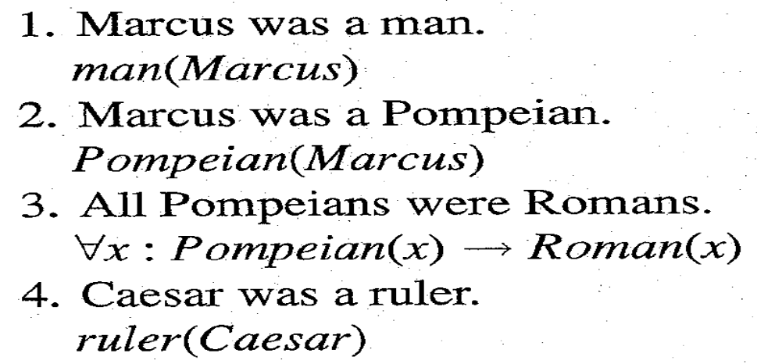
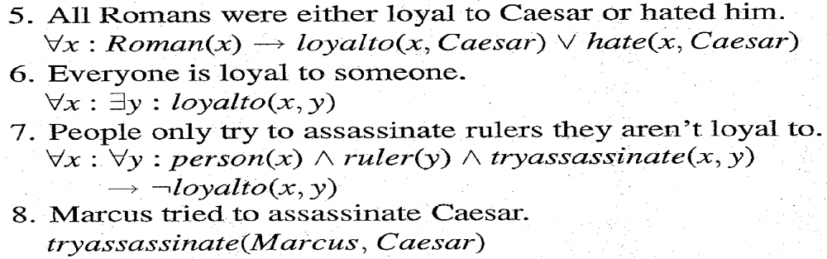
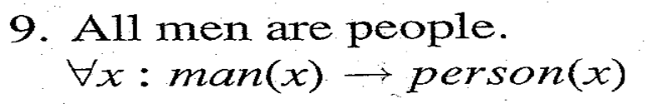
A Predicate Logic Example

Slide 11
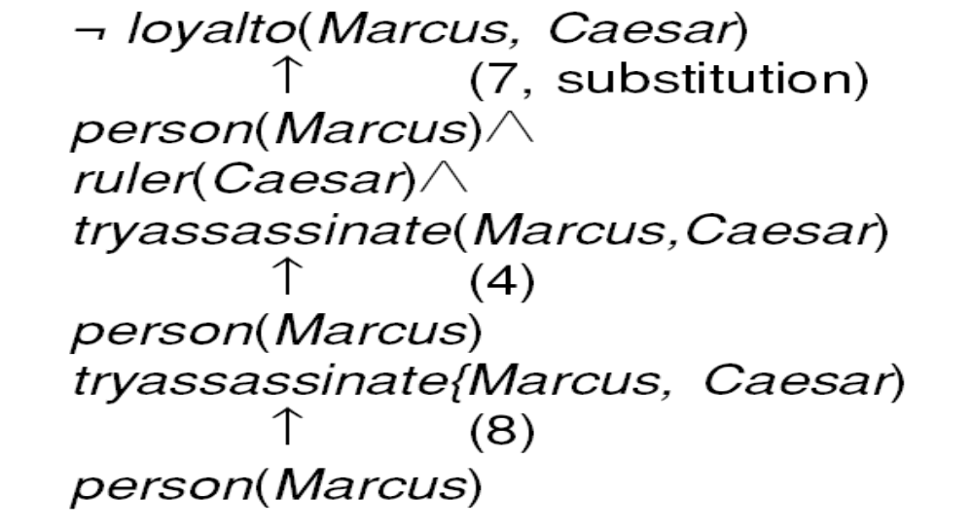





An Attempt to Prove

Slide 12
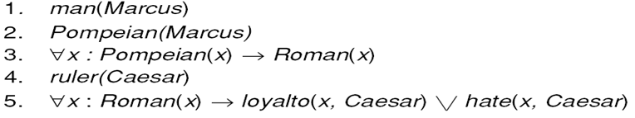
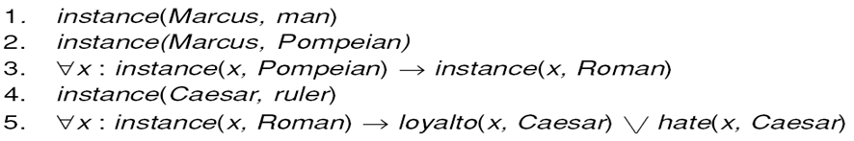
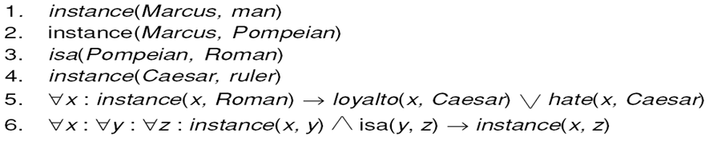
Three Ways of Representing
Class Membership

Slide 13
Overriding Defaults
Make Paulus an exception to the general rule about the
Romans and their feeling towards Caesar.
Suppose we add:
But now we have a problem with 5:
So we need to change it to :
Every exception to a general rule must be stated twice, once in a particular statement
And once in exception list that forms part of general rule

Slide 14
Another Predicate Logic Example
Marcus was a man.
Marcus was a Pompeian.
Marcus was born in 40 A.D.
All men are mortal.
All Pompeians died when the volcano erupted in 79 A.D.
No mortal lives longer than 150 years.
It is now 1991.
Is Marcus alive?
Alive means not dead.
If someone dies, then he is dead at all later times.

Slide 15
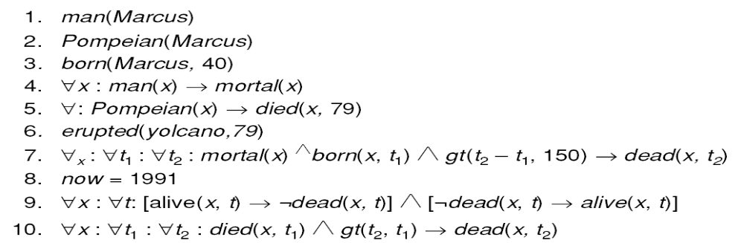
A Set of Facts about Marcus
Computable predicates

Slide 16
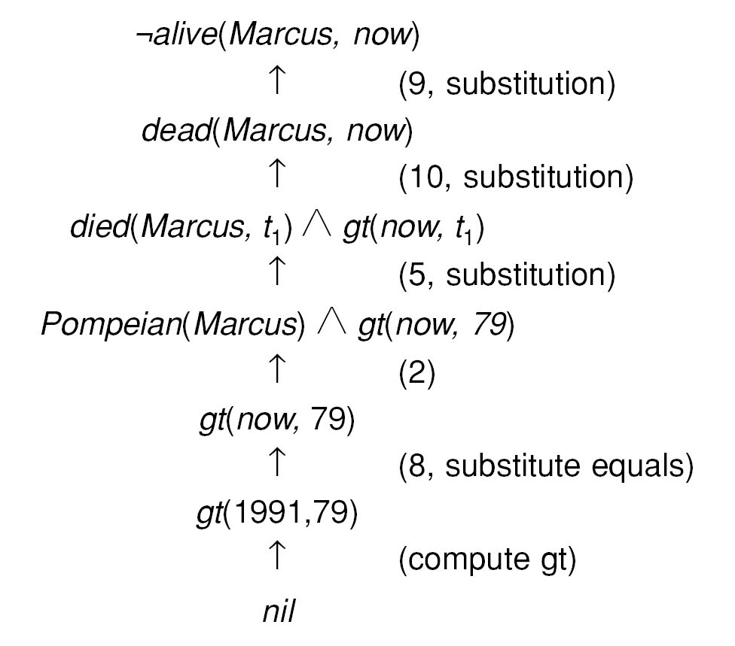
One Way of Proving That Marcus Is Dead
The term nil at end of each proof indicate that the list of conditions remaining is empty
So the proof has succeeded.

Slide 17
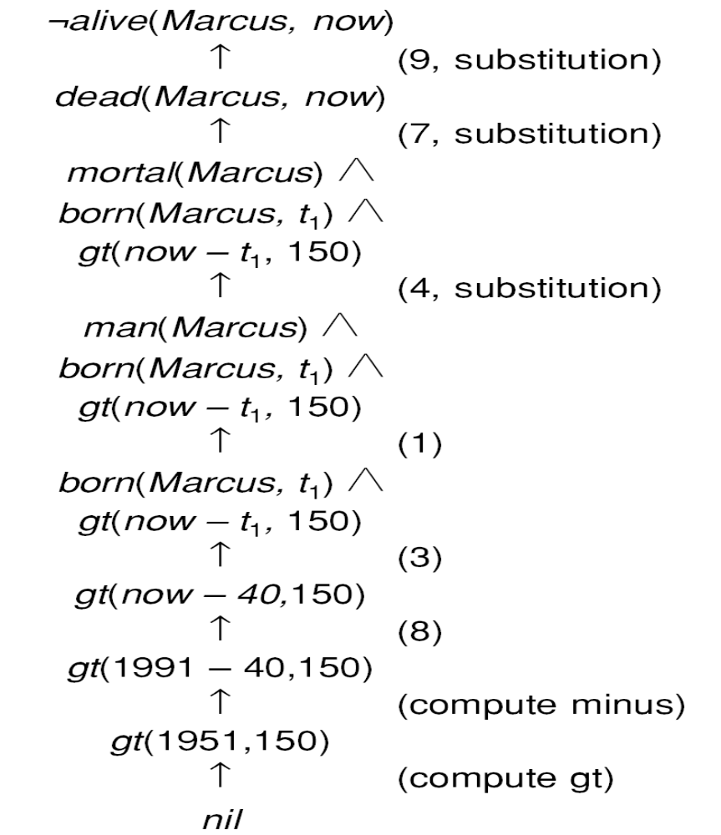
Another Way of Proving That Marcus Is Dead
Very simple conclusion can
require many steps to prove.
A variety of processes such as
Matching, substitution and application
of modus ponens are involved in
production of proof.

Slide 18
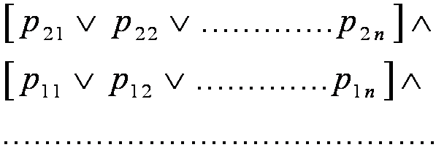
Resolution
Resolution produces proof by refutation. i.e. to prove a statement, resolution attempts to show that the negation of statement produces a contradiction with known statements.
This approach contrast with technique that we have been using to generate proofs by chaining backward from theorem to be proved axioms.
It operates on statements that have been converted to a very convenient standard form.
The formula would be easier to work with if
  It were flatter i.e. there was less embedding of components.
  The quantifiers were separated from the rest of formula so they did not need to be consider.
Conjunctive Normal Form (CNF)has both these properties.

Slide 19
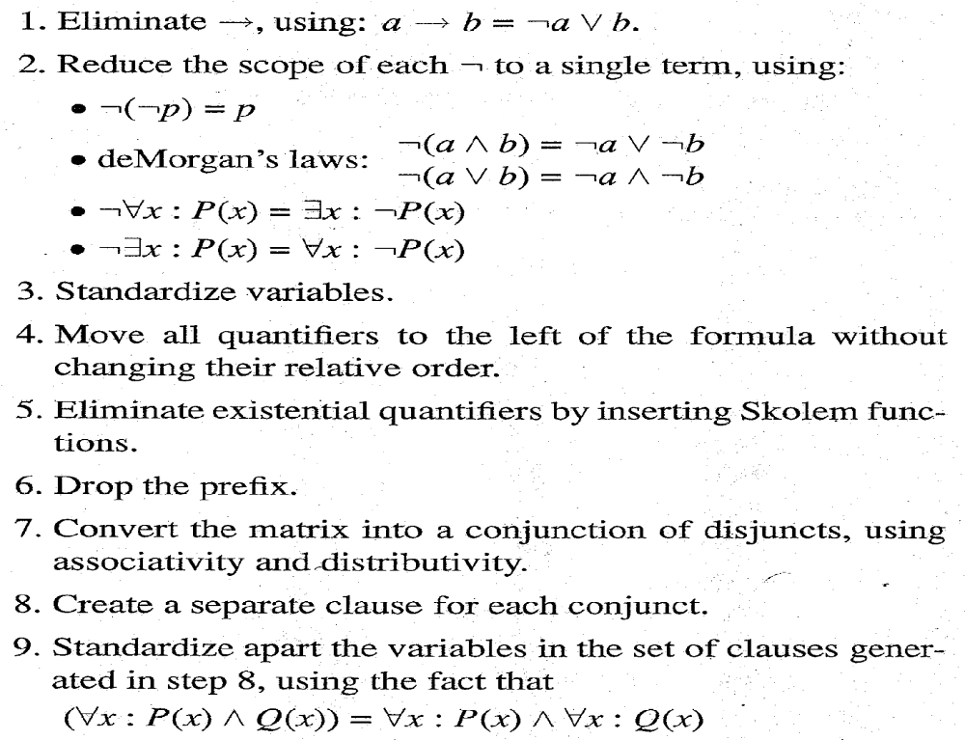
Algorithm : Convert to Clause Form

Slide 20
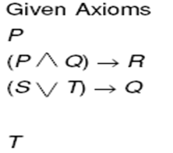
Examples of Conversion to Clause Form

Slide 21
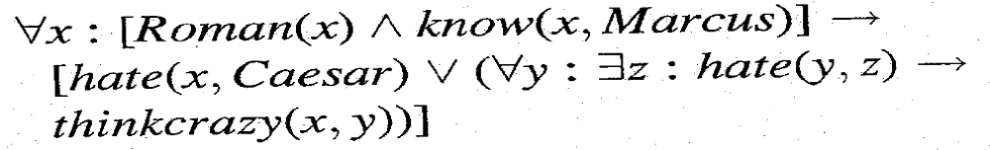


Examples of Conversion to Clause Form
Suppose we know that all Romans who know Marcus either hate Caesar or think
That anyone who hates anyone is crazy.
Example :
1 Eliminate 
2 Reduce scope of
3 Standardize Variables.

Slide 22





Examples of Conversion to Clause Form
4 Move quantifiers.
Prenex normal form
5 Eliminate existential quantifiers.
will be converted to
while
will be converted to
6 Drop the prefix.
7 Convert to a conjunction of disjuncts.

Slide 23
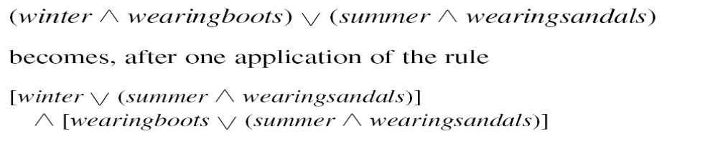
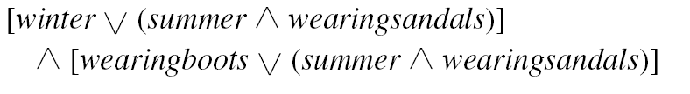
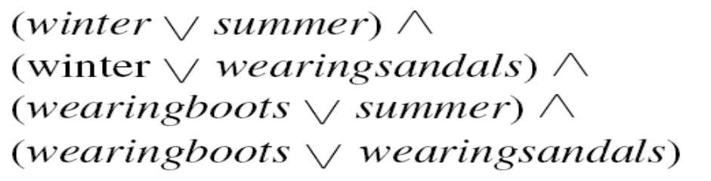
Convert a matrix to conjunction of disjuncts.
The Formula
becomes
and then becomes

Slide 24


